Slide 1

Hospital management system
Presented by-
Ashwini.k
Entrollment no:EBEON0922657806
Batch:792

Slide 2
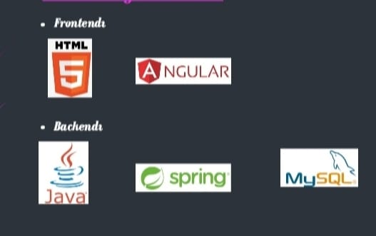
Technologies are used

Slide 3
Aim of the project
A hospital management system , integrated information system designed the administrative, financial and clinical aspects of a hospital.
Support of clinical and medical patient care activities in the hospital.
Administration of the hospital daily business transactions.
Evalution of hospital performance and cost,and projection of the long-term forecast.

Slide 4
Project scope
The main aim of our project is to provide a paper-less hospital up to 90%. It also aims at providing low-cost reliable automation of the existing systems. The system also provides excellent security of data at every level of user-system interaction and also provides robust & reliable storage and backup facilities.

Slide 5
Modules of HMS
Patient registration Without hospital management software, hospitals may suffer since they can easily lose manually written notes in case of an unfavourable situation. HMS is essential to hospitals for patient registration. ...
Electronic Health records (EHR) ...
In-patient department: ...
Out-patient department: ...
Inventory tracking system: ...
Vaccination modules: ...
Communication with the patient: ...
Billing: ...

Slide 6
Screenshots

Slide 7
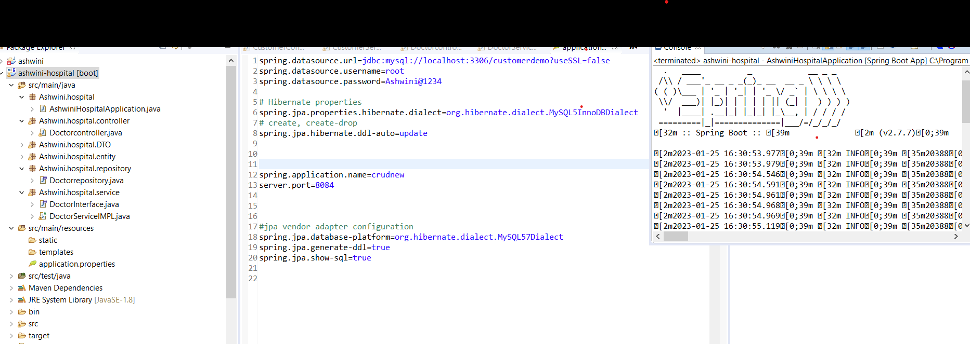

Slide 8
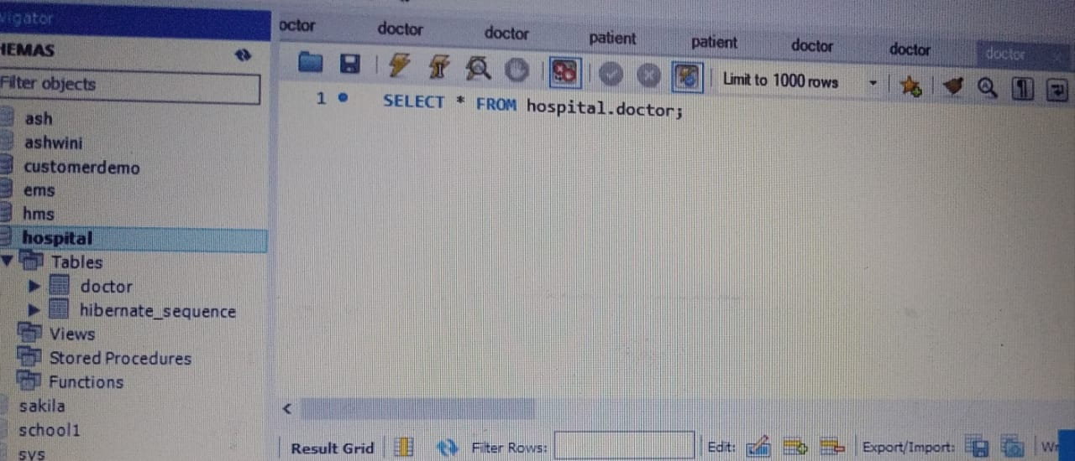

Slide 9
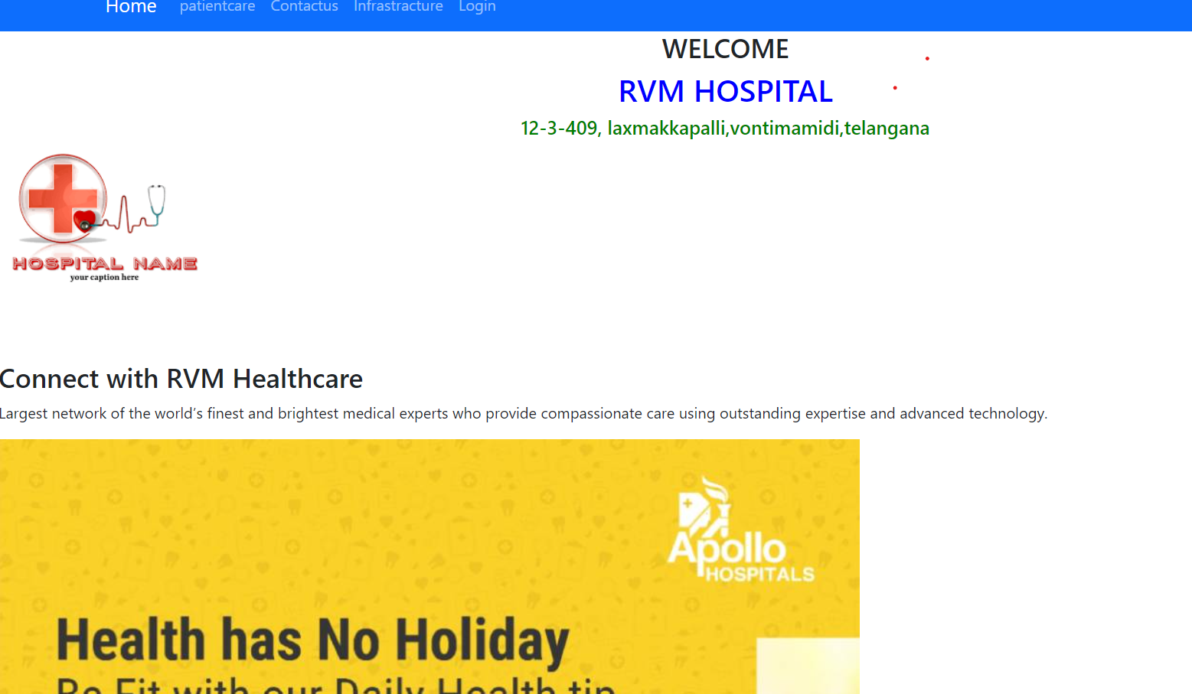

Slide 10
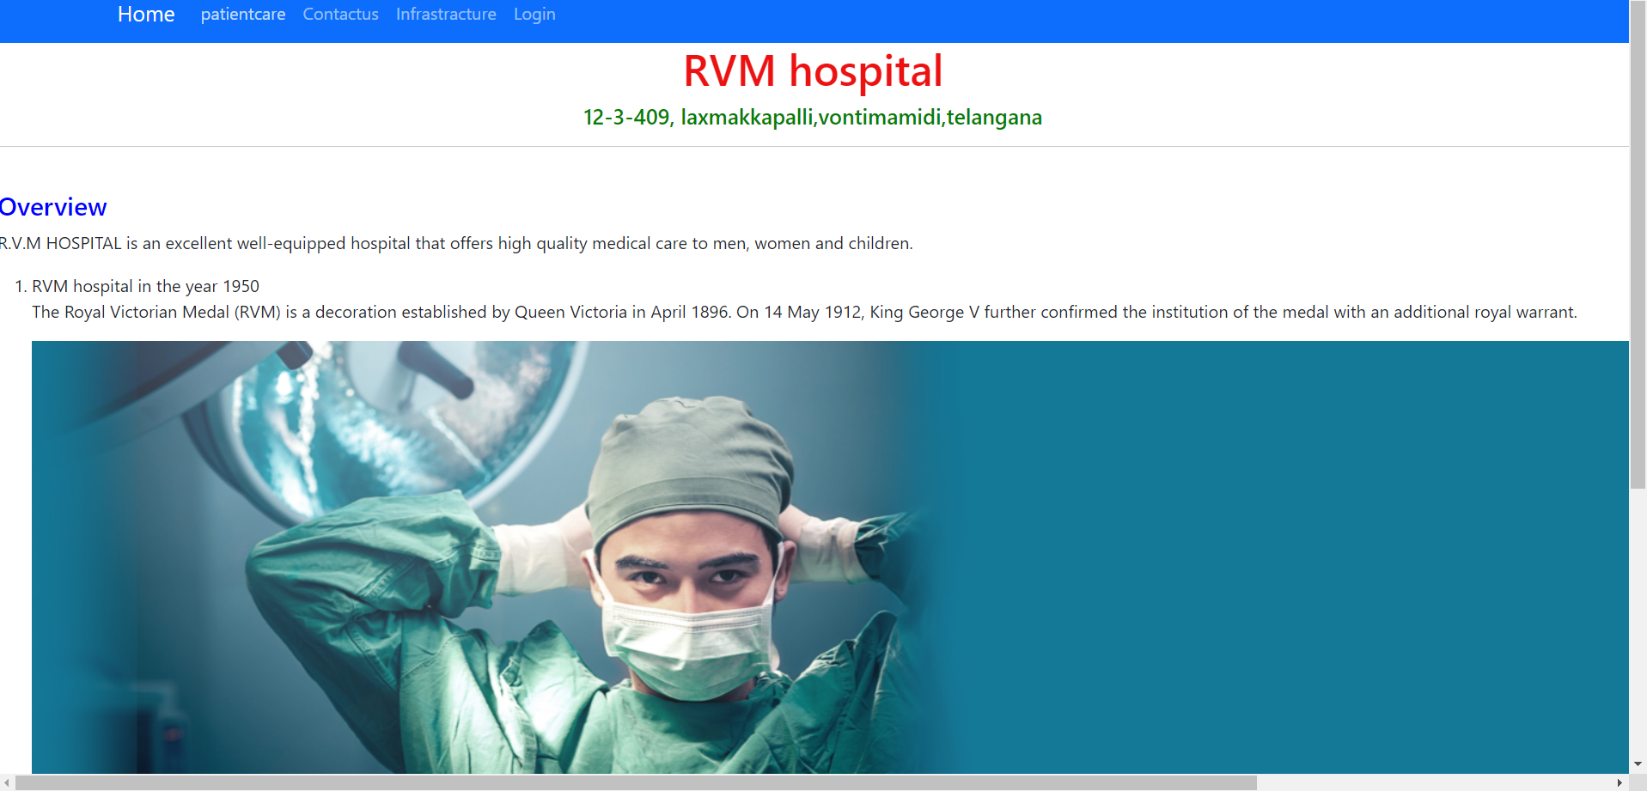

Slide 11
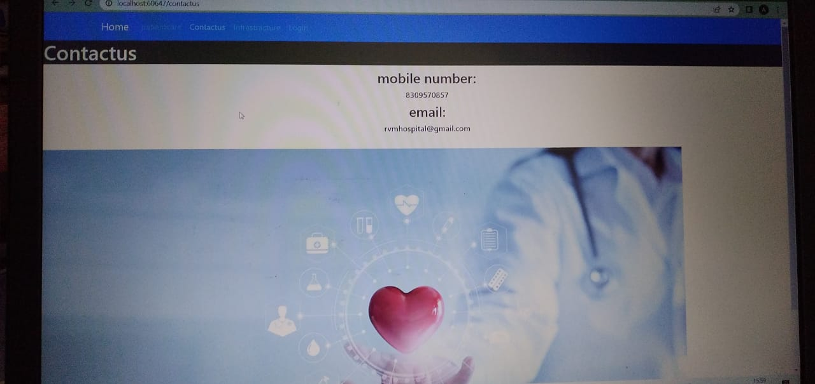

Slide 12
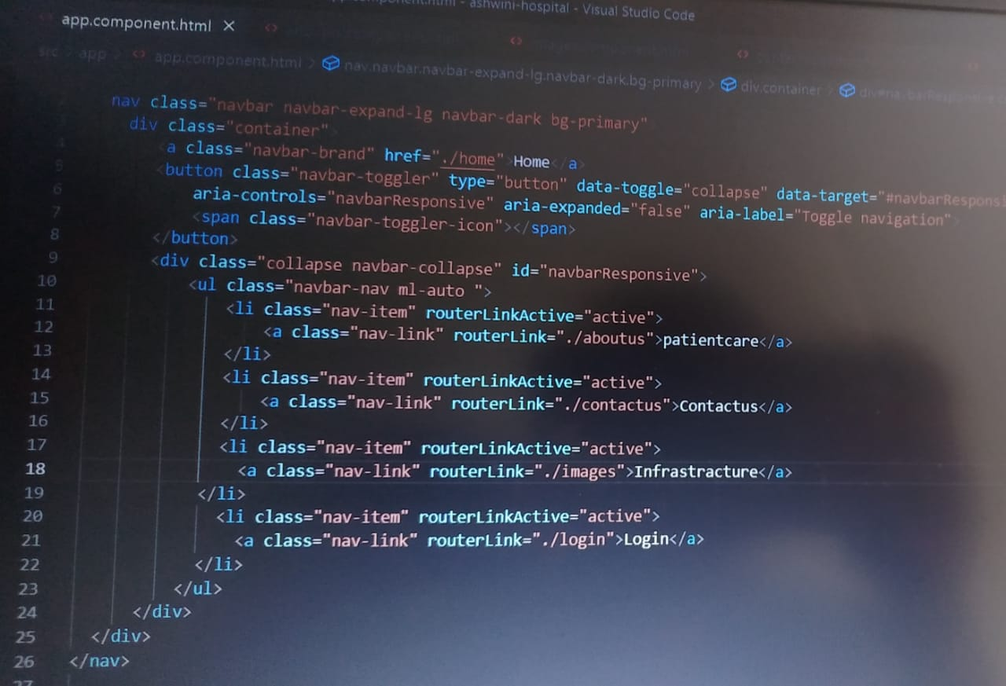

Slide 13
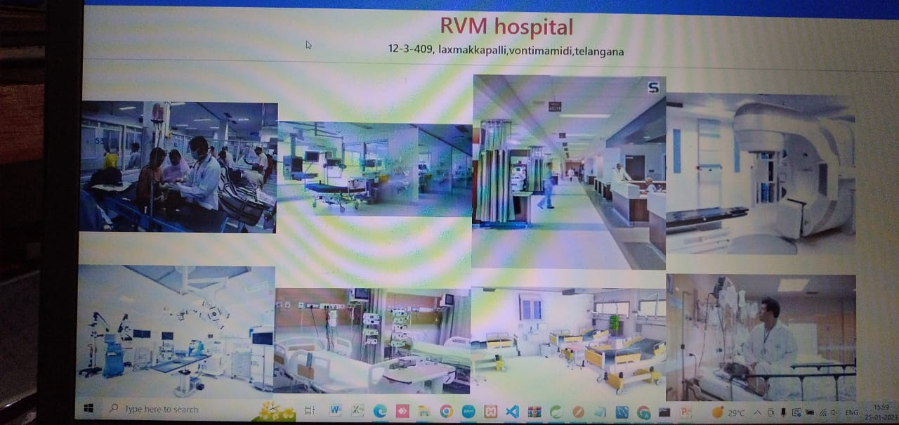

Slide 14
Scope of improvements
Improved Processes.
Digital medical records.
Staff interaction.
Facility management.
Financial control and tax planning.
Market strategy.
Insurance claims processing.

Slide 15
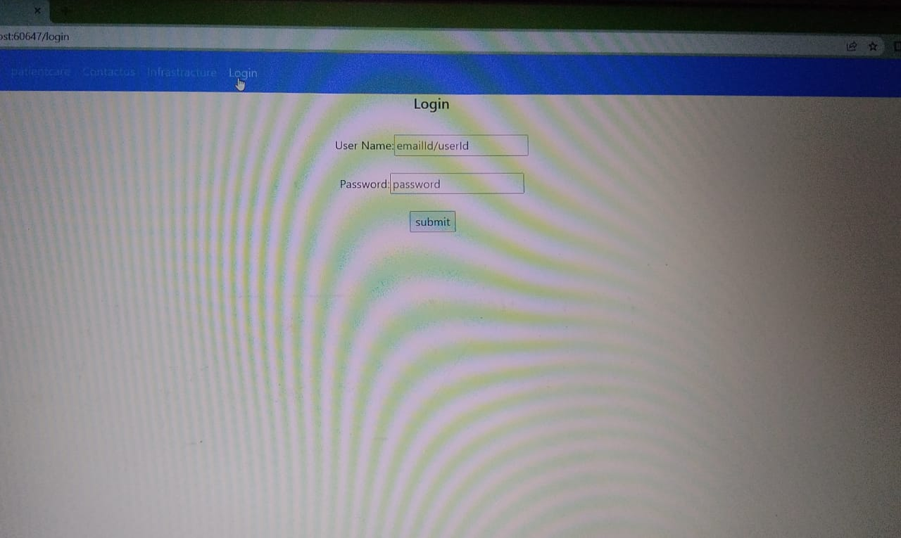

Slide 16
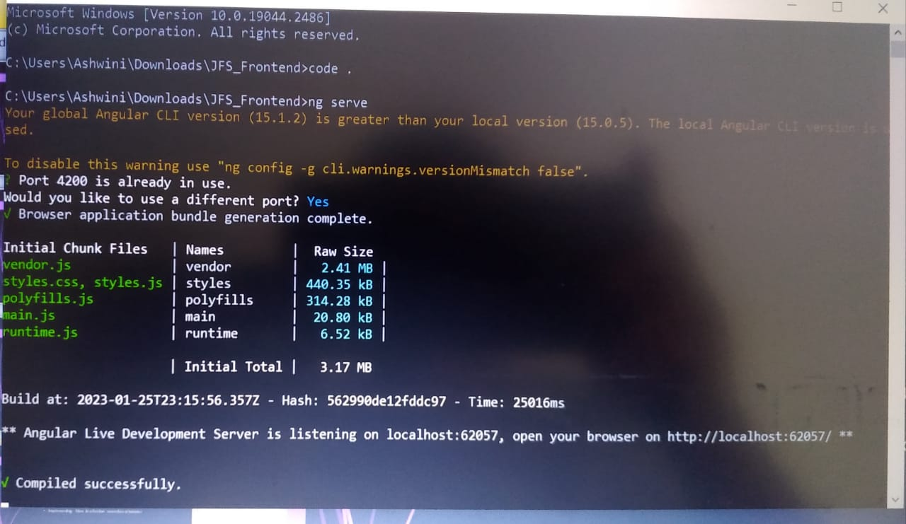

Slide 17


